Slide 1

Examining the Relationship Between Water Availability and Adoption of Adaptation Measures
Annie Brinza
Jingjing Li
Nicole Levin
Investigator: Mariana Vedoveto
Notes:
My name is Annie Brinza, and my group mates are Jingjing Li and Nicole Levin. Our project this semester was to examine the relationship between water availability and adoption of adaptation measures in the Brazilian Amazon. The investigator of our project was Mariana Vedoveto

Slide 2
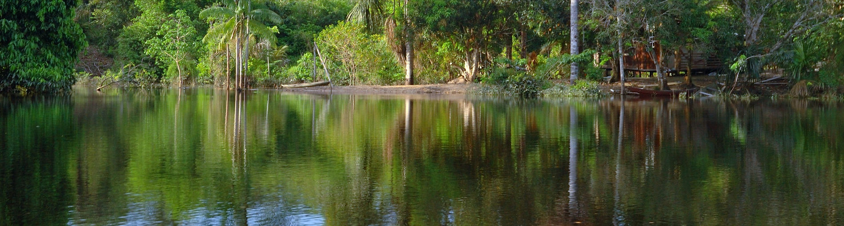
Project Background
Collaboration between 7 universities
Goal is to provide actionable knowledge about connections between water and rural production
Improve human well-being while conserving Amazonian ecosystems
Notes:
This project is a collaboration between seven universities and has spanned decades. The overall goal of the project is to provide researchers and policymakers with actionable knowledge about connections between water and rural production that can help local communities make informed decisions to improve human well-being while conserving Amazonian ecosystems.

Slide 3
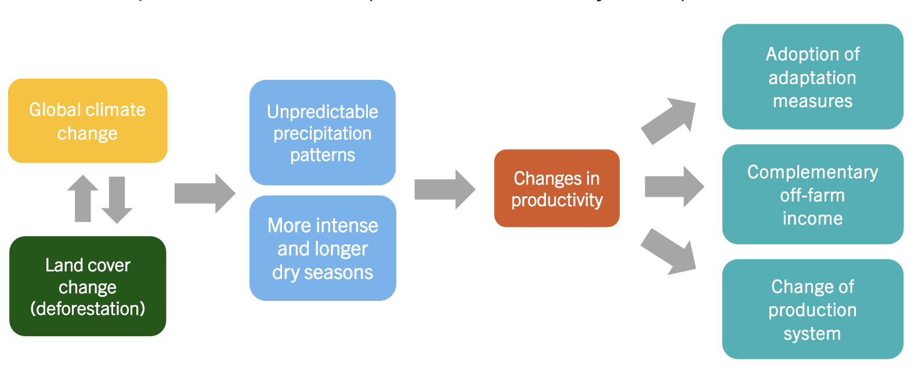
Project Background – Our Focus
Investigator Mariana Vedoveto is interested specifically in adoption of adaptation measures in response to water availability
Adaptation measures include cattle management, water management, pasture management, and forest conservation
Will use results of analysis to create recommendations for adaptation that minimizes further risk to ecosystem
Notes:
Our investigator’s hypothesis is that changes in water availability influence farmers’ decisions on adopting adaptation measures. For this project, four types of adaptation measures are considered – cattle management, changing from crops to cattle, water management, such as creating ponds on the land, pasture management, such as fallowing the land, and forest conservation, such as setting land aside for forest regeneration
If the relationship between the two can be better understood, recommendations can be made for how the farmers should adapt in a way that minimizes further risk to the ecosystem. As an example – if farmers are more likely to clear additional land in order to try and grow more crops with less water available, that deforestation can lead to worse climate instability and further water vulnerability (WORD BETTER).

Slide 4
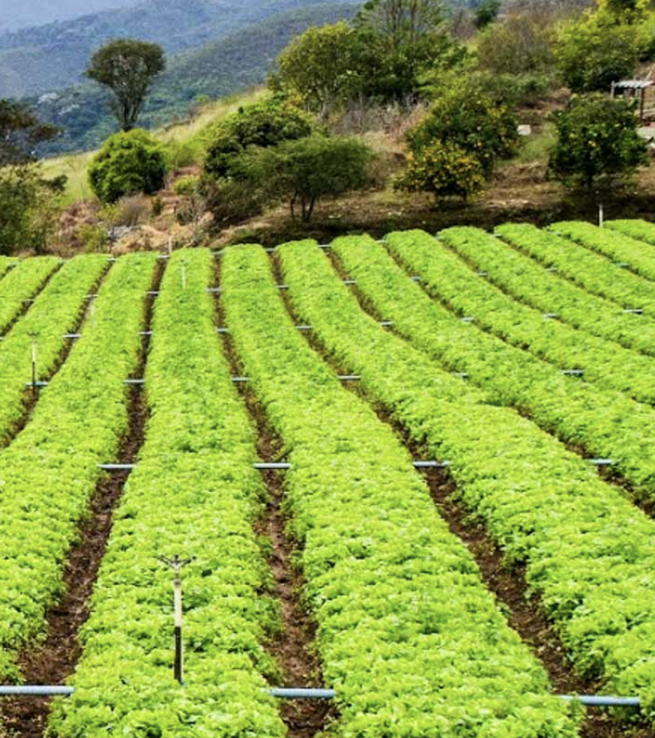
Research Questions
Is there a statistically significant relationship between water availability and the adoption of adaptation methods among rural farmers in Brazil?
How does this vary by level of wealth?
How does this vary by adaptation method?
Notes:
Now that you understand the project background, I would like to dive deeper into the research questions we worked on answering
The primary question of focus is: Is there a statistically significant relationship between water availability and the adoption of adaptation methods among rural farmers in Brazil?
This is important for our researcher because she needs to understand how farmers are adapting to the water availability issues, and if any of them are taking a route that could make climate change even worse and result in a positive feedback cycle.
She has two sub-hypotheses: Adaptation will vary depending on level of wealth, since some methods are more expensive to implement. The other is some adaptation methods will be more popular across all farmers, and will possibly correlate more closely with water availability issues

Slide 5
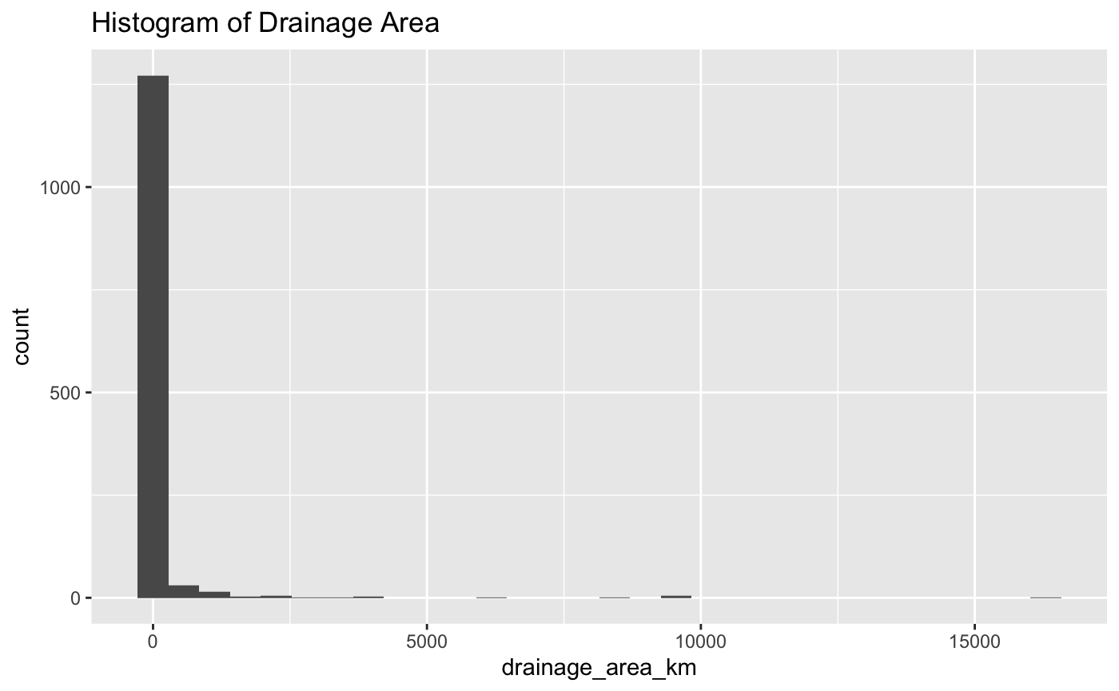
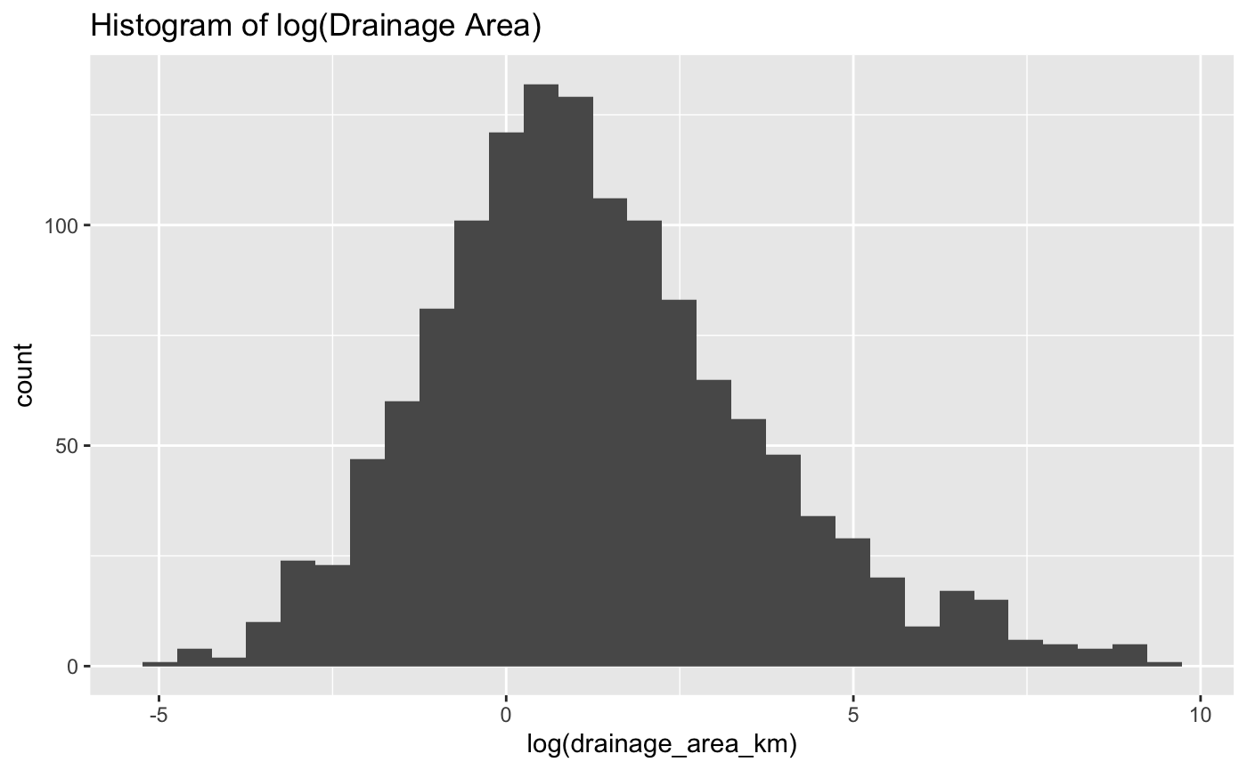

Results: Simple Logistic Regression
Modeled any adaptation with log(drainage area) as the only predictor
Why use the log transformation of drainage area?
Model Summary:
Coefficient | Estimate | Standard Error | z Value | p Value
Intercept | 2.00718 | 0.09431 | 21.282 | <2x10-¹⁶
log(drainage area) | 0.10519 | 0.03962 | 2.655 | 0.00792
Notes:
Now we can go through some of our logistic regression modeling results
Our first model was a simple logistic regression model for any adaptation with drainage area as the only predictor variable. This model did not show a significant relationship.
We next looked at a natural log transformation for drainage area. You can see the long tail on the drainage area distribution in the histogram on the left.
Taking the natural log of drainage area gives us the more even distribution in the histogram on the right.
Here we saw a significant relationship, as you can see in the model summary with a p-value much lower than 0.05 for the log of drainage area

Slide 6
Results: Separating by Adaptation Category
Cattle Management
Water Management
Pasture Management
Forest Conservation
Coefficient | Estimate | Std. Error | z Value | p Value
Intercept | -0.58609 | 0.06488 | -9.033 | <2x10-¹⁶
log(drainage area) | 0.05162 | 0.02374 | 2.174 | 0.0297
Coefficient | Estimate | Std. Error | z Value | p Value
Intercept | 0.16275 | 0.06229 | 2.613 | 0.00898
log(drainage area) | 0.09512 | 0.02396 | 3.971 | 7.17x10⁻⁵
Coefficient | Estimate | Std. Error | z Value | p Value
Intercept | 1.71958 | 0.08552 | 20.108 | <2x10-¹⁶
log(drainage area) | 0.06572 | 0.03416 | 1.924 | 0.0543
Coefficient | Estimate | Std. Error | z Value | p Value
Intercept | 1.30277 | 0.07451 | 17.485 | <2x10-¹⁶
log(drainage area) | 0.17455 | 0.03290 | 5.305 | 1.12x10⁻⁷
Notes:
We also modeled the logistic regression for our four categories of adaptation individually: cattle management, water management, pasture management, and forest conservation with the natural log of drainage area as the only predictor variable.
We saw a significant relationship between the natural log of drainage area and adaptation, with very small p-values for pasture management and forest conservation.
Evidence of a relationship between water management and log(drainage area) looks the weakest, with a p-value of .054 and cattle management fell in between with a p-value of .0297

Slide 7
Results: Looking at Wealth
Cattle Management
Water Management
Pasture Management
Forest Conservation
Coefficient | Estimate | Std. Error | z Value | p Value
Intercept | -6.724x10⁻¹ | 7.585x10⁻² | -8.866 | <2x10-¹⁶
Vehicle Value | 6.795x10⁻⁶ | 1.005x10⁻⁶ | 6.763 | 1.35x10⁻¹¹
Coefficient | Estimate | Std. Error | z Value | p Value
Intercept | 2.314x10⁻¹ | 7.769x10⁻² | 2.978 | 0.0029
Vehicle Value | 7.489x10⁻⁶ | 1.288x10⁻⁶ | 5.813 | 6.12x10⁻⁹
Coefficient | Estimate | Std. Error | z Value | p Value
Intercept | 2.833 | 1.817x10⁻¹ | 15.588 | <2x10-¹⁶
Vehicle Value | 7.353x10⁻⁶ | 3.675x10⁻⁶ | 2.001 | 0.0454
Coefficient | Estimate | Std. Error | z Value | p Value
Intercept | 2.059 | 1.260x10⁻¹ | 16.340 | <2x10-¹⁶
Vehicle Value | 5.742x10⁻⁶ | 2.253x10⁻⁶ | 2.549 | 0.0108
Notes:
Now we can look at the relationship between wealth and adaptation. In our analysis, vehicle value is used as a proxy for wealth.
We looked at logistic regression models of each of our four categories of adaptation with vehicle value as the only predictor variable. We saw a significant relationship for each category of adaptation.
The results here show very small p-values for the vehicle value coefficient when looking at cattle management and pasture management. We see higher, but still significant, p-values for water management and forest conservation

Slide 8
Results: Models with Wealth and Drainage Area
Cattle Management
Water Management
Pasture Management
Forest Conservation
Coefficient | Estimate | Std. Error | z Value | p Value
Intercept | -6.776x10⁻¹ | 8.061x10⁻⁻² | -8.407 | <2x10-¹⁶
Vehicle Value | 6.768x10⁻⁶ | 1.014x10⁻⁶ | 6.672 | 2.52x10⁻¹¹
log(Drainage Area) | 4.919x10⁻³ | 2.559x10⁻² | 0.192 | 0.848
Coefficient | Estimate | Std. Error | z Value | p Value
Intercept | 1.764x10⁻¹ | 8.196x10⁻² | 2.152 | 0.0314
Vehicle Value | 7.178x10⁻⁶ | 1.293x10⁻⁶ | 5.553 | 2.81x10⁻⁸
log(Drainage Area) | 5.432x10⁻² | 2.627x10⁻² | 2.068 | 0.0387
Coefficient | Estimate | Std. Error | z Value | p Value
Intercept | 2.921 | 1.999x10⁻¹¹ | 14.616 | <2x10-¹⁶
Vehicle Value | 7.799x10⁻⁶ | 3.710x10⁻⁶ | 2.102 | 0.0355
log(Drainage Area) | -7.259x10⁻² | 5.769x10⁻² | -1.258 | 0.2083
Coefficient | Estimate | Std. Error | z Value | p Value
Intercept | 1.938 | 1.266x10⁻¹ | 15.313 | <2x10-¹⁶
Vehicle Value | 4.393x10⁻⁶ | 2.241x10⁻⁶ | 1.960 | 0.05
log(Drainage Area) | 2.058x10⁻¹ | 4.851x10⁻² | 4.242 | 2.22x10⁻⁵
Notes:
We also looked at logistic regression models with wealth and natural log of drainage area as predictors. Wealth, in the form of vehicle value, is significant in all of these models, but drainage area was only significant for forest conservation and pasture management.

Slide 9
Final Summary
The overall goal of our project was to look at the relationship between water availability and adaptation measures
We saw a significant relationship between the natural log of drainage area and adaptation
We saw a significant relationship between the natural log of drainage area and individual adaptation categories
We saw a significant relationship between wealth and each category of adaptation
When wealth and drainage area are both used as predictors, wealth is significant for all four categories of adaptation and natural log of drainage area is only significant for forest conservation and pasture management

